Slide 1
Healthy Families Kent County - HFKC
2024

Slide 2
Program Overview
Healthy Families Kent County (HFKC) is a home visiting program that works with Kent County families who have two forms of identified risk to help strengthen the bond between parent and child.
Goals:
Cultivate and strengthen nurturing parent-child relationships. ​
Promote healthy growth and development. ​
Enhance family functioning by reducing risk and building protective factors. ​
Build and sustain community partnerships
Notes:
Susan will do the intro
Bek slides 1-5
Me 6-8, success story and what board can assist with
Work with FF and CCWM

Slide 3
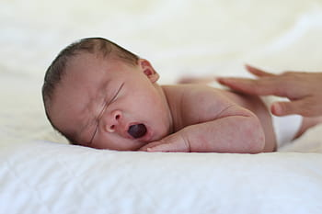
Program Services
Child Development Resources​
Referrals to Resources​
Relationship Building​
Parent Support Groups​
Trusted Support​
Maternal and Infant Healthcare​
Family Goal Planning

Slide 4
Our Diverse Team – Strength in Differences
Director
Supervisor
6 Family Support Specialist
Supervisor
3 Family Support Specialist
62% are Bilingual
17% are Hispanic or Other
83% are Caucasian
100% Female

Slide 5
Families Served in 2023
2124 Total Home Visits in 2023
126 Total Families Served
120 Target Children with an additional 153 siblings

Slide 6
Exciting Outcomes
98% of Target children are up to date on well child visits.
99% of families received at least one resource and/or follow up service.
503 Community Referrals Provided
Nearly 83% of families served reported having stayed in services for 3yrs and successfully graduated.
93% of participants increased child development and parenting knowledge.
Notes:
Parent Feedback-areas of life that have improved with HFKC:
Understanding of child development and parenting
Ability to read my child’s cues
Support system
More appreciation of my child
More patience with my child’s behavior
My ability to solve problems
More patience with my child’s behavior

Slide 7
What’s New for FY24
Substance Use Disorder (SUD) Funding through Healthy Moms Healthy Babies!
Partnering with DHHS and Corewell Health to pilot new state-funded program to serve an additional 48 families impacted by SUD.
Expansion of the Team – 1 Supervisor and 3 Home Visitors

Slide 8
Funding Sources:
Maternal Infant Early Childhood Home Visiting (MIECHV)​
Kent County Prevention Initiative (KCPI)​
Ready by Five
American Rescue Plan (ARP)​​
Healthy Mom's Healthy Babies
Children’s Trust Michigan

Slide 9
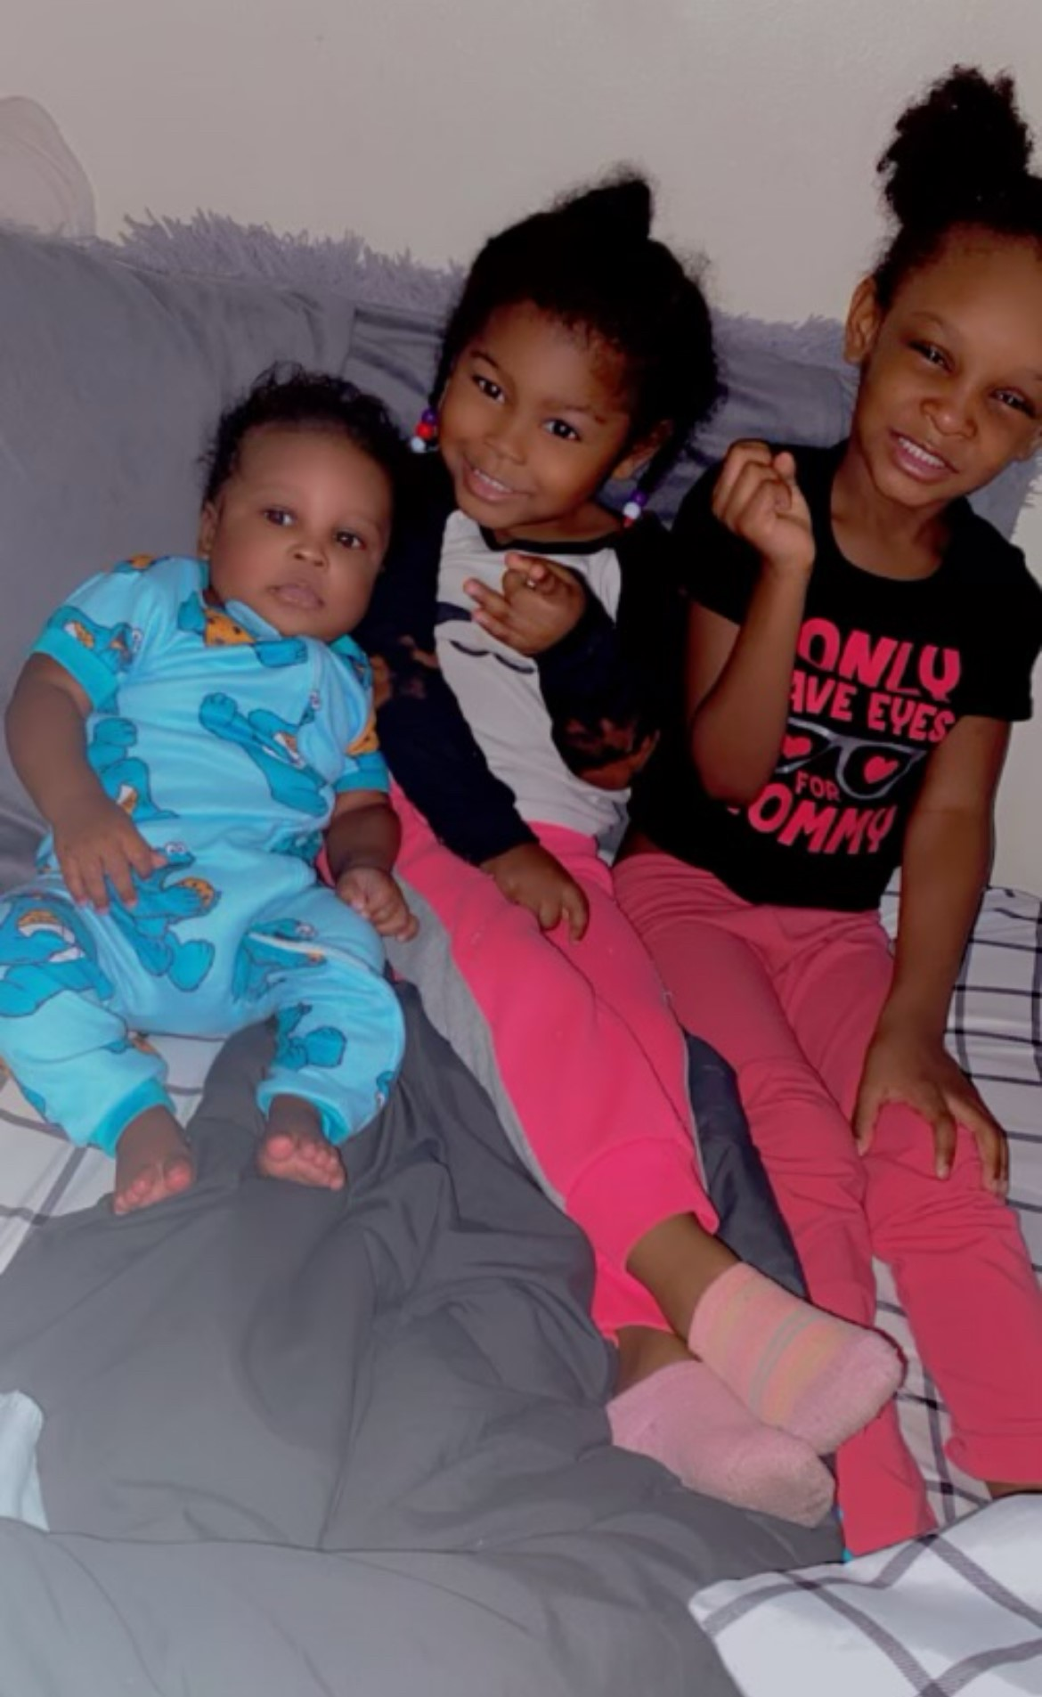
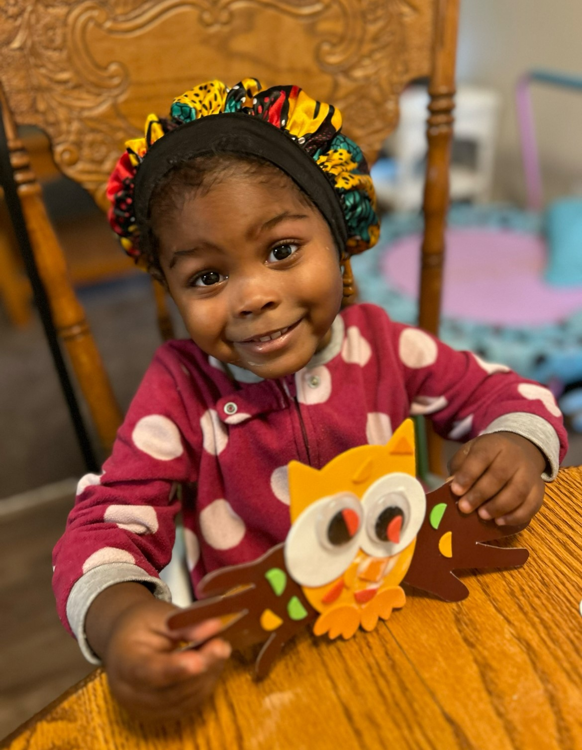
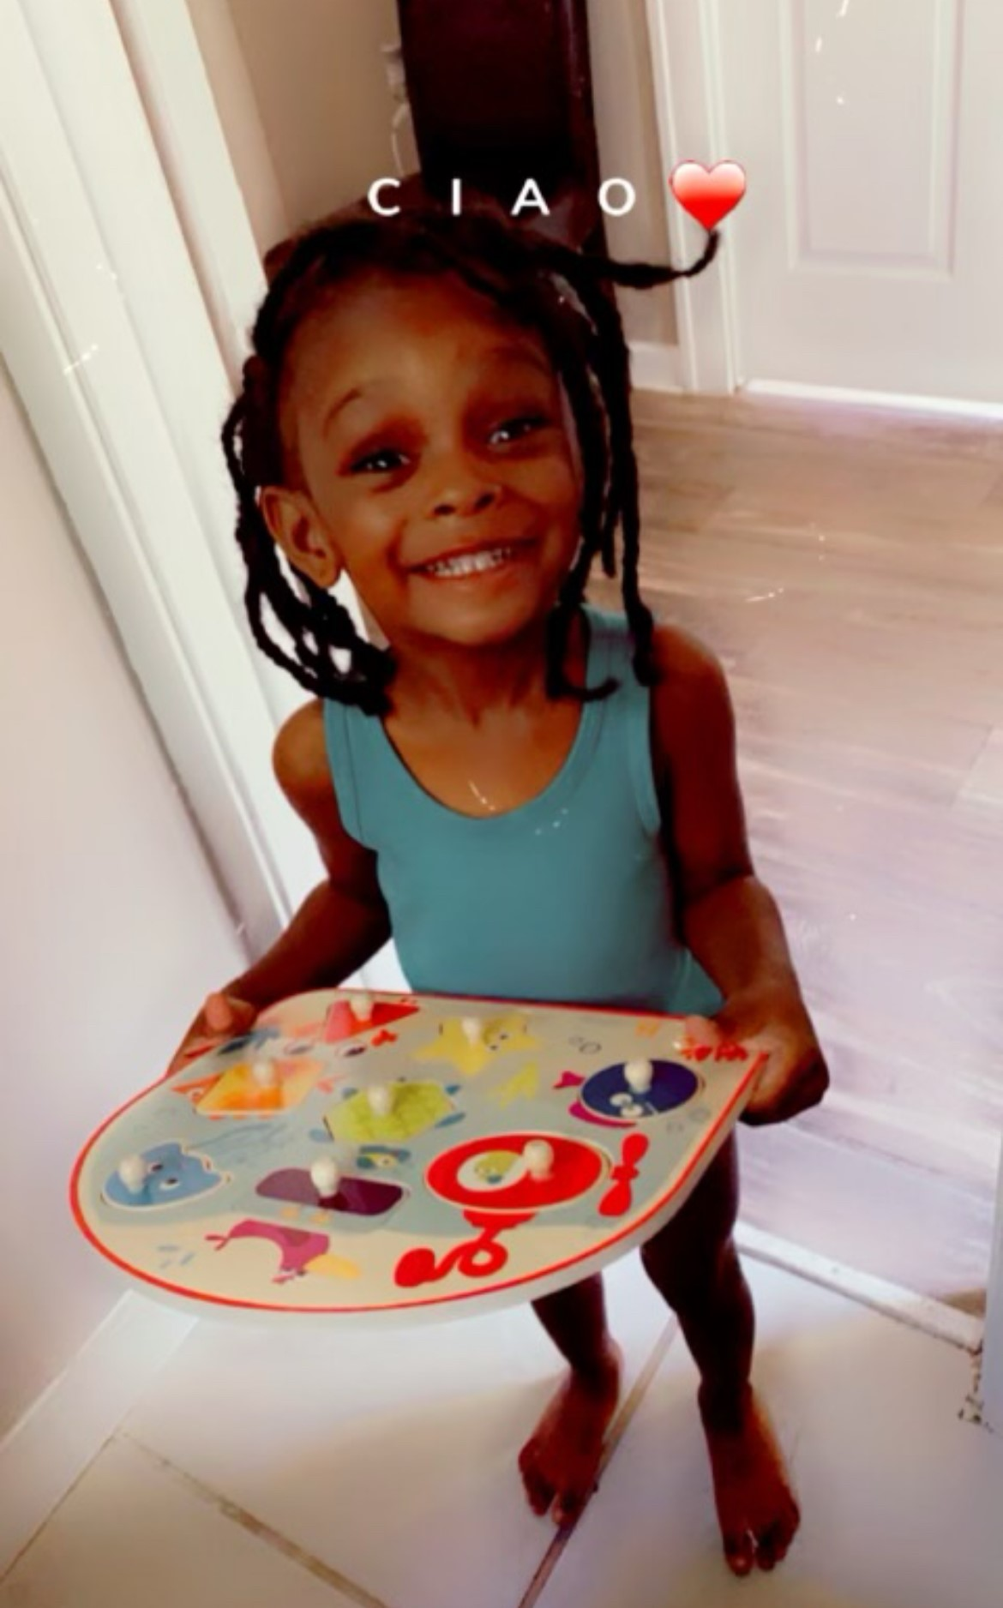
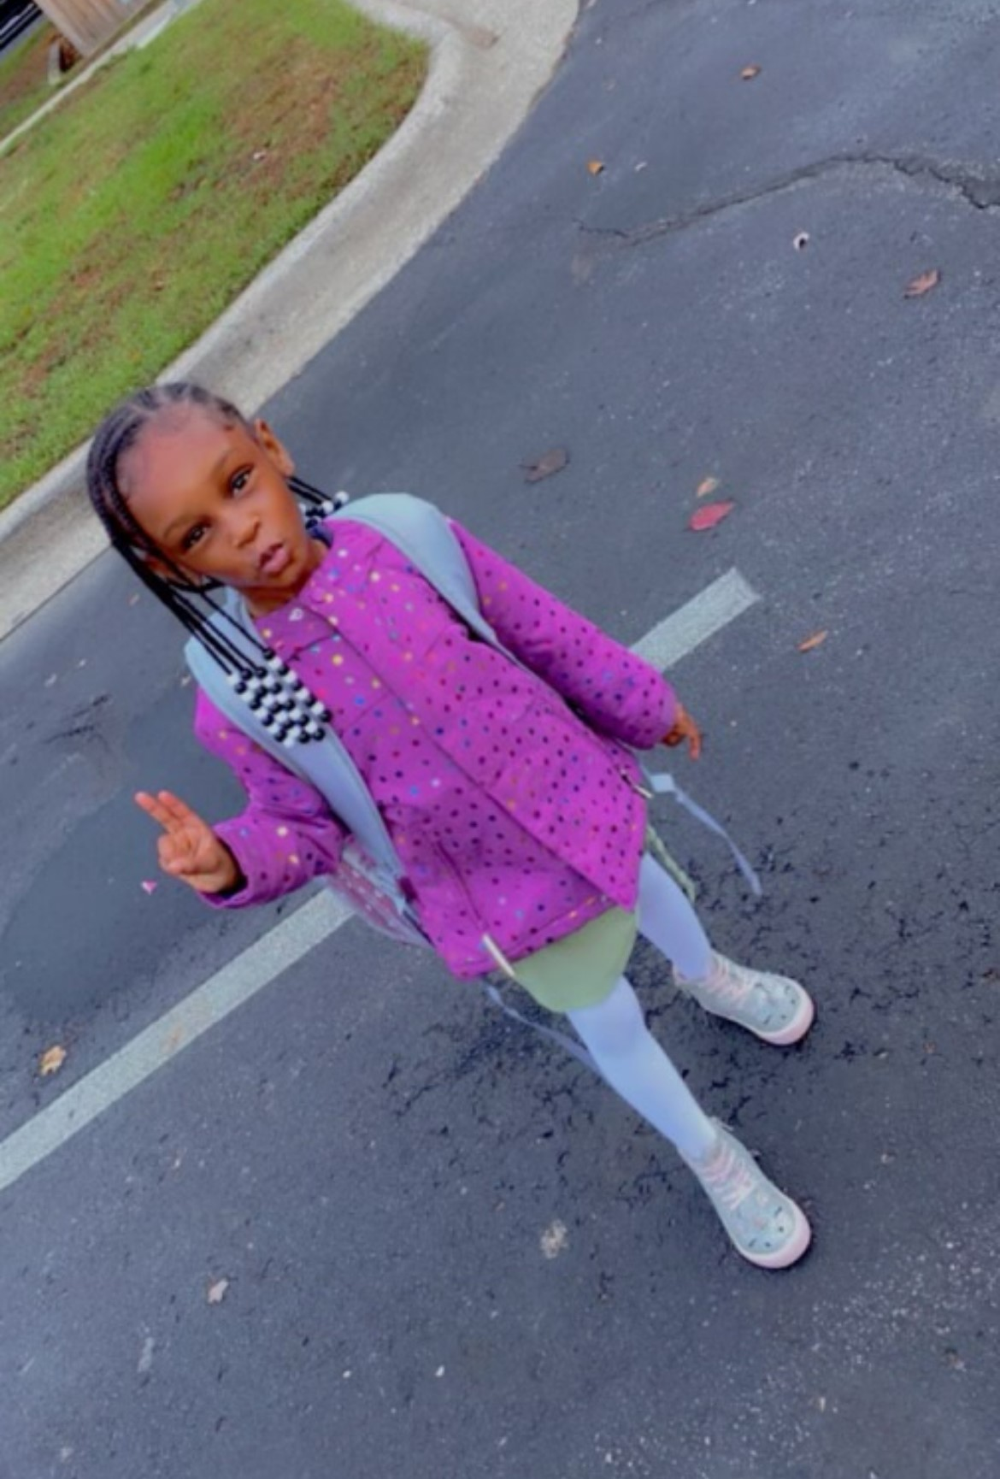
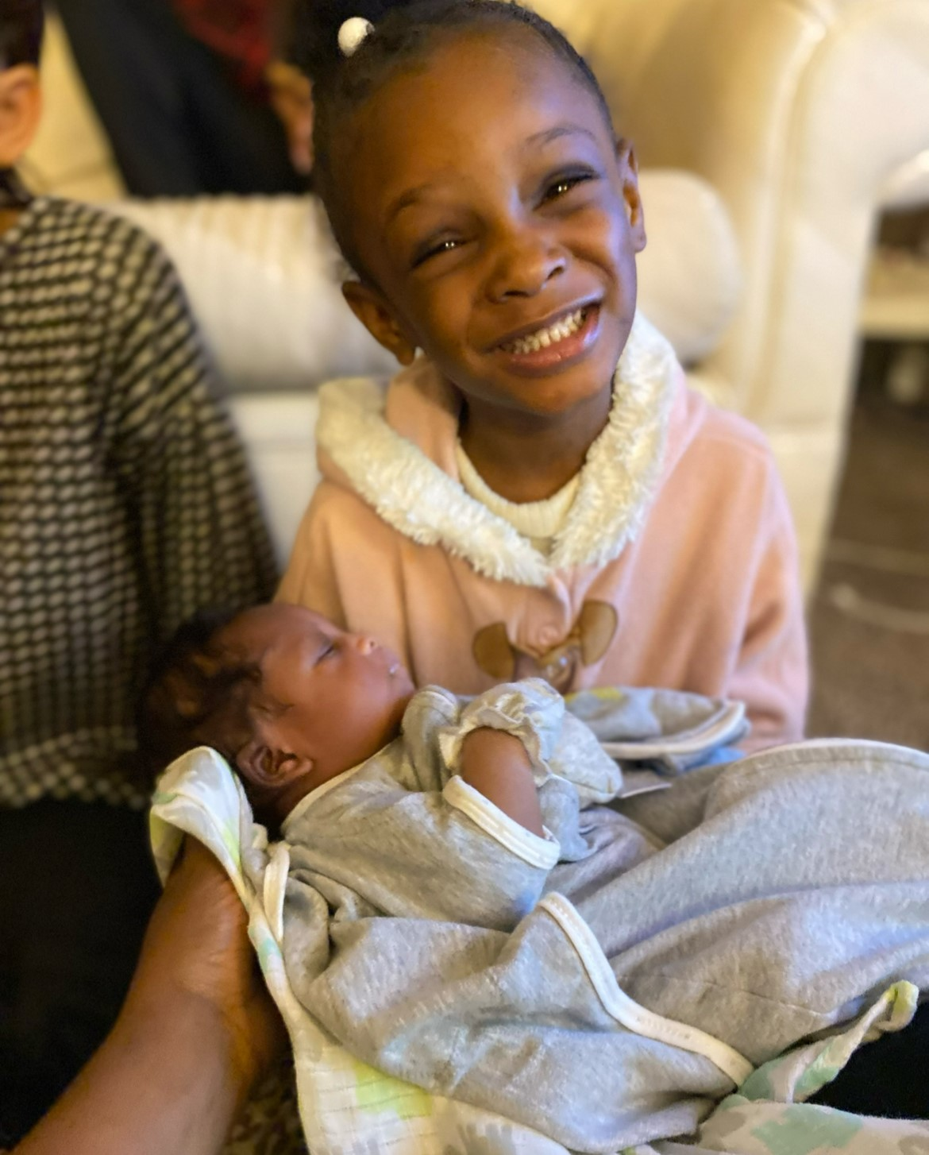
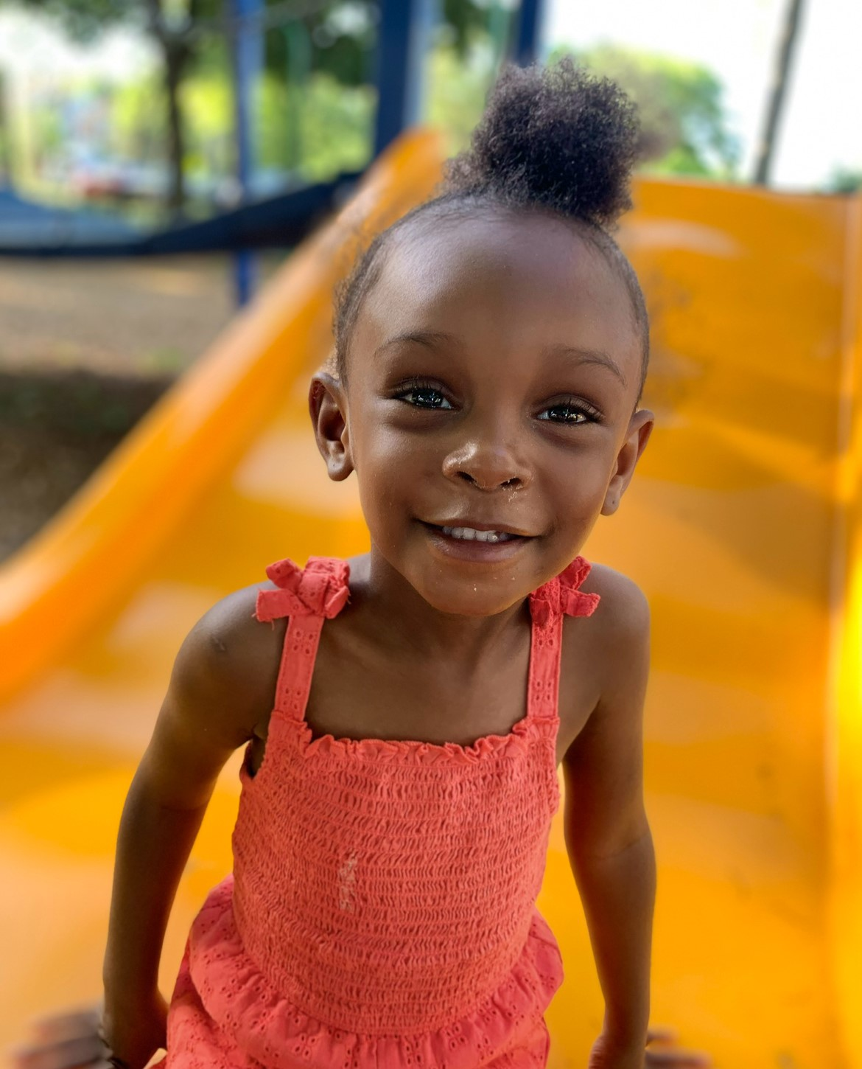
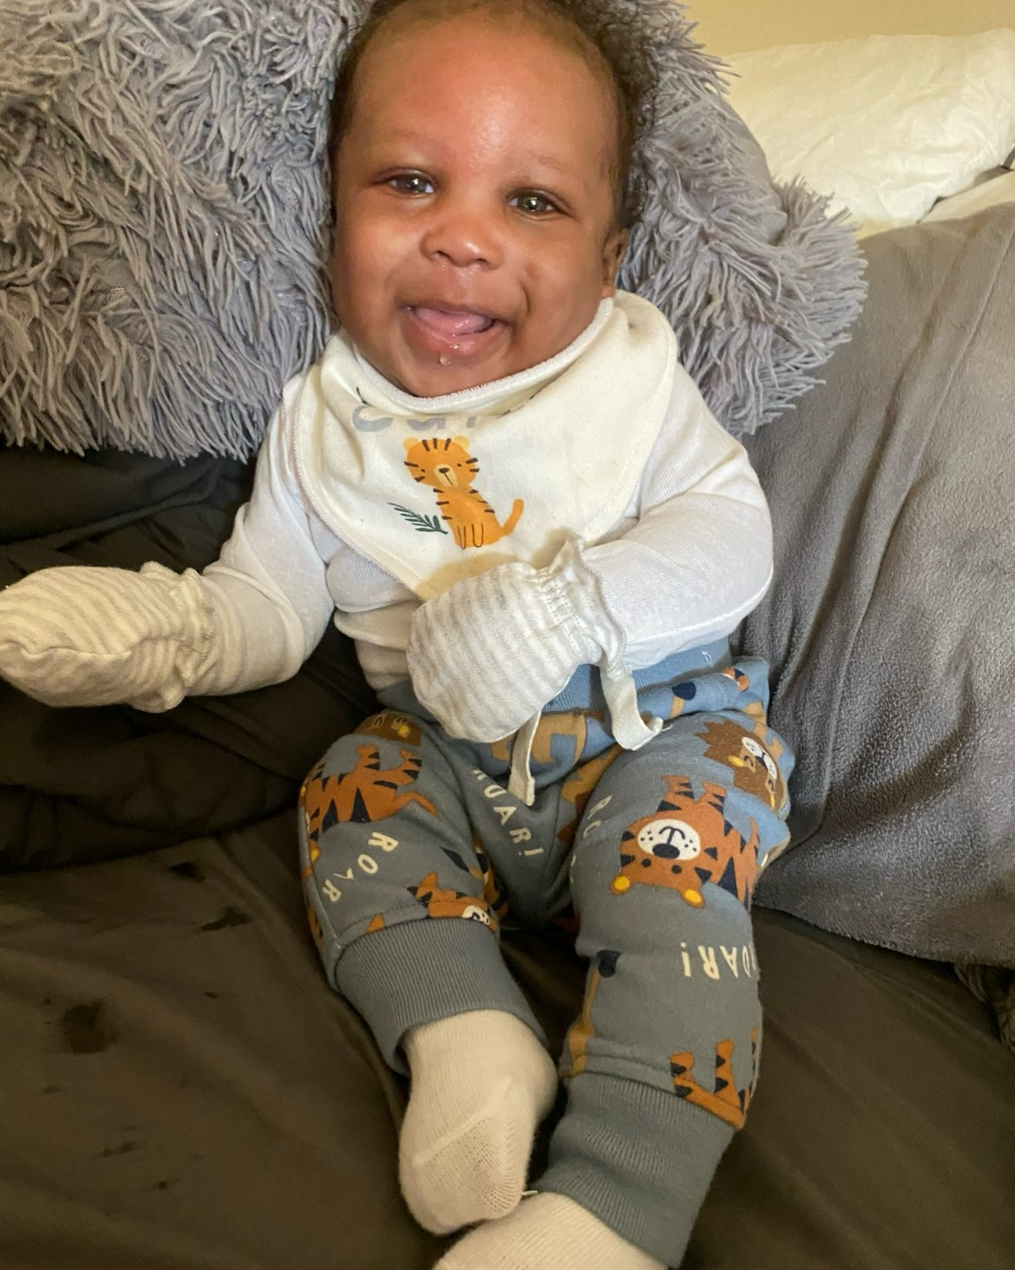
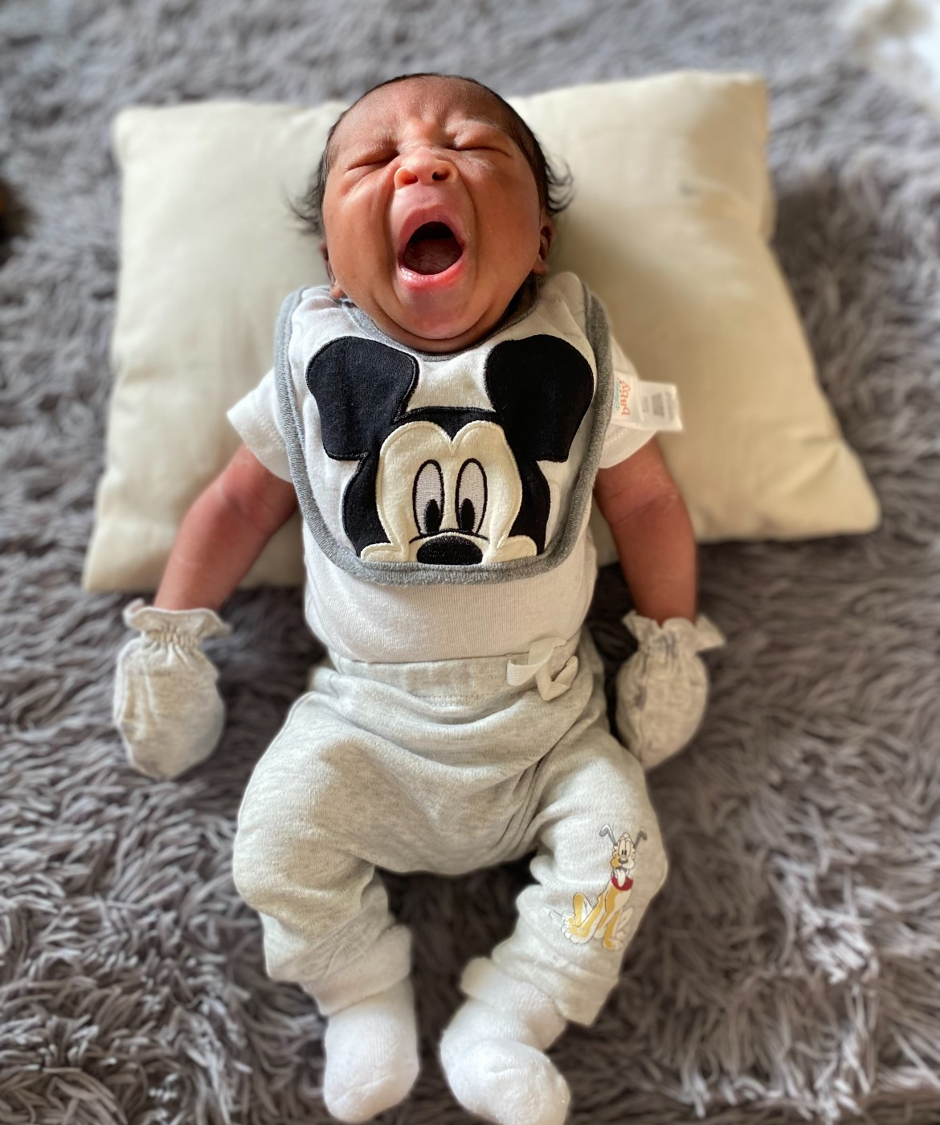
Success Story

Slide 10
Questions?
Visit the Healthy Families Kent County page on familyfutures.org to learn more!

